Slide 1
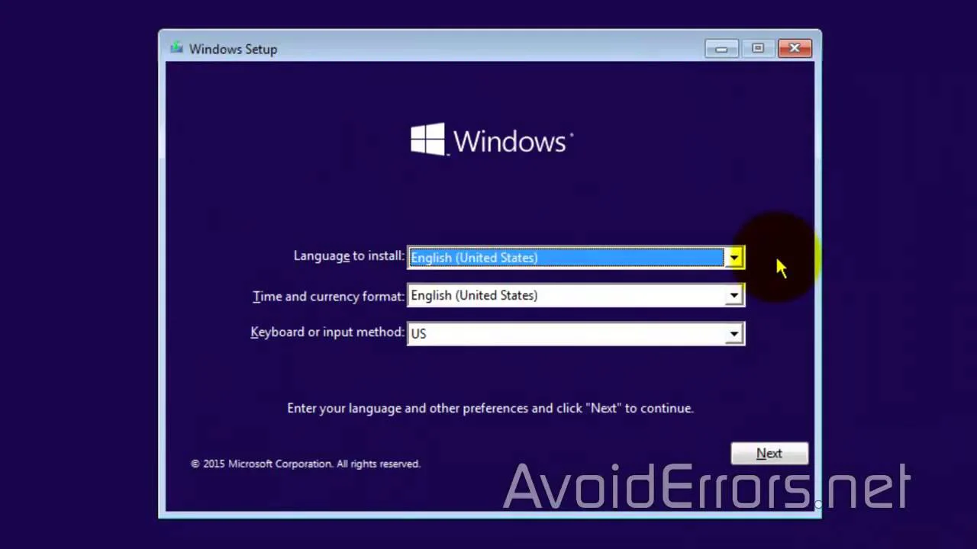

Slide 2
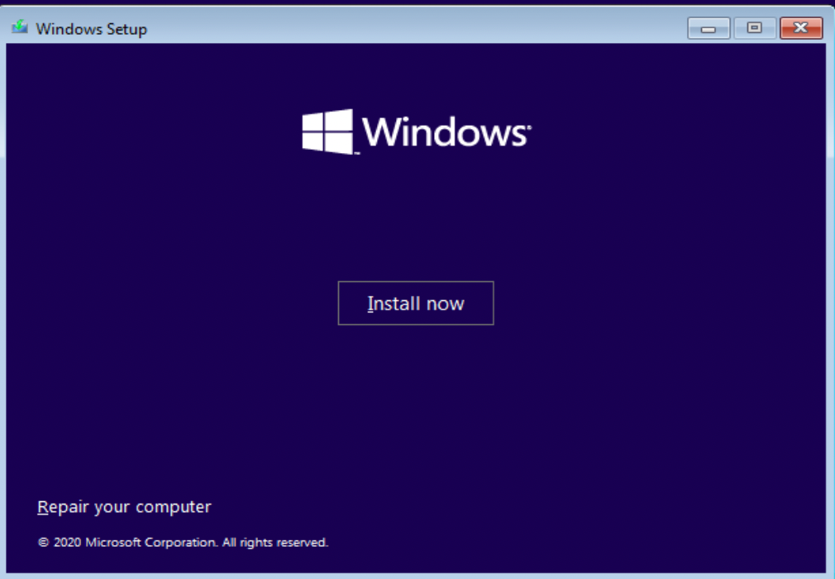

Slide 3
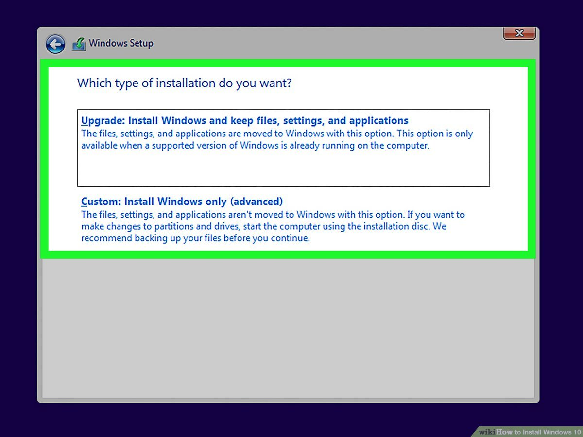

Slide 4
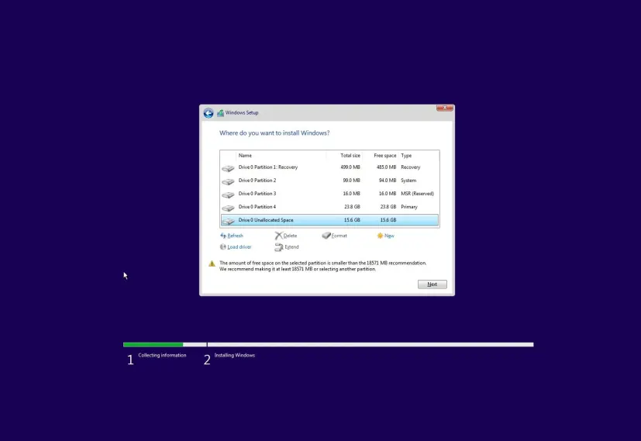

Slide 5
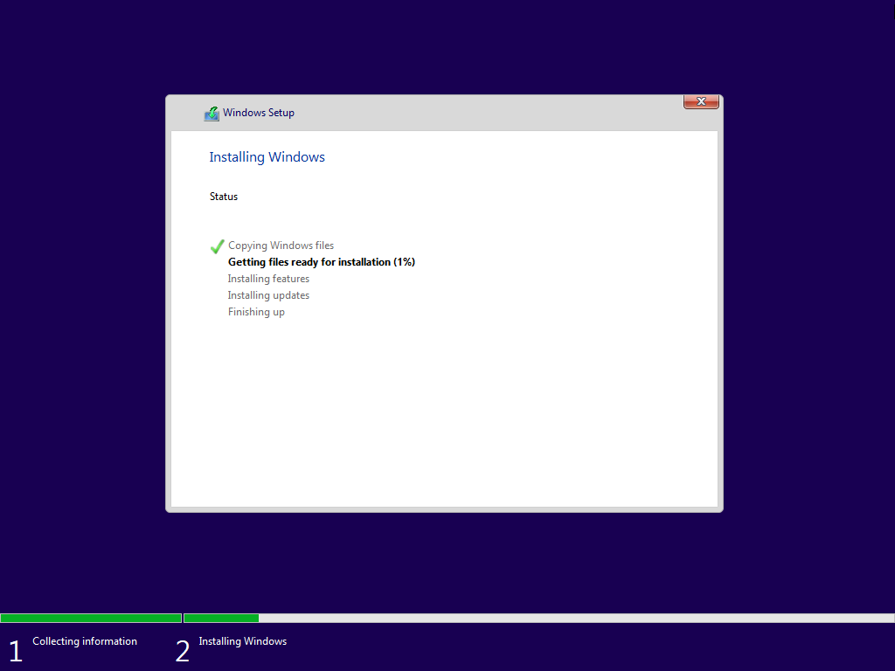

Slide 6
2%

Slide 7
3%

Slide 8
4%

Slide 9
11%

Slide 10
12%

Slide 11
13%

Slide 12
14%

Slide 13
15%

Slide 14
20%
Idk my pc is fast

Slide 15
21%
Idk my pc is fast

Slide 16
22%
Idk my pc is fast

Slide 17
24%
Idk my pc is fast

Slide 18
25%
Idk my pc is fast

Slide 19
30%
Idk my pc is fast

Slide 20
31%
Idk my pc is fast

Slide 21
32%
Idk my pc is fast

Slide 22
34%
Idk my pc is fast

Slide 23
40%
Idk my pc is fast

Slide 24
41%
Idk my pc is fast

Slide 25
42%
Idk my pc is fast

Slide 26
43%
Idk my pc is fast

Slide 27
44%
Idk my pc is fast

Slide 28
45%
Idk my pc is fast

Slide 29
46%
Idk my pc is fast

Slide 30
47%
Idk my pc is fast

Slide 31
48%
Idk my pc is fast

Slide 32
49%
Idk my pc is fast

Slide 33
51%
Idk my pc is fast

Slide 34
52%
Idk my pc is fast

Slide 35
53%
Idk my pc is fast

Slide 36
54%
Idk my pc is fast

Slide 37
55%
Idk my pc is fast

Slide 38
56%
Idk my pc is fast

Slide 39
57%
Idk my pc is fast

Slide 40
58%
Idk my pc is fast

Slide 41
59%
Idk my pc is fast

Slide 42
60%
Idk my pc is fast

Slide 43
61%
Idk my pc is fast

Slide 44
62%
Idk my pc is fast

Slide 45
63%
Idk my pc is fast

Slide 46
64%
Idk my pc is fast

Slide 47
65%
Idk my pc is fast

Slide 48
66%
Idk my pc is fast

Slide 49
67%
Idk my pc is fast

Slide 50
68%
Idk my pc is fast

Slide 51
69%
Idk my pc is fast

Slide 52
70%
Idk my pc is fast

Slide 53
71%
Idk my pc is fast

Slide 54
73%
Idk my pc is fast

Slide 55
74%
Idk my pc is fast

Slide 56
75%
Idk my pc is fast

Slide 57
76%
Idk my pc is fast

Slide 58
77%
Idk my pc is fast

Slide 59
78%
Idk my pc is fast

Slide 60
79%
Idk my pc is fast

Slide 61
80%
Idk my pc is fast

Slide 62
81%
Idk my pc is fast

Slide 63
82%
Idk my pc is fast

Slide 64
83%
Idk my pc is fast

Slide 65
84%
Idk my pc is fast

Slide 66
85%
Idk my pc is fast

Slide 67
86%
Idk my pc is fast

Slide 68
88%
Idk my pc is fast

Slide 69
88%
Idk my pc is fast

Slide 70
88%
Idk my pc is fast

Slide 71
89%
Idk my pc is fast

Slide 72
90%
Idk my pc is fast

Slide 73
91%
Idk my pc is fast

Slide 74
92%
Idk my pc is fast

Slide 75
93%
Idk my pc is fast

Slide 76
94%
Idk my pc is fast

Slide 77
95%
Idk my pc is fast

Slide 78
96%
Idk my pc is fast

Slide 79
97%
Idk my pc is fast

Slide 80
98%
Idk my pc is fast

Slide 81
99%
Idk my pc is fast

Slide 82
100%
Idk my pc is fast

Slide 83
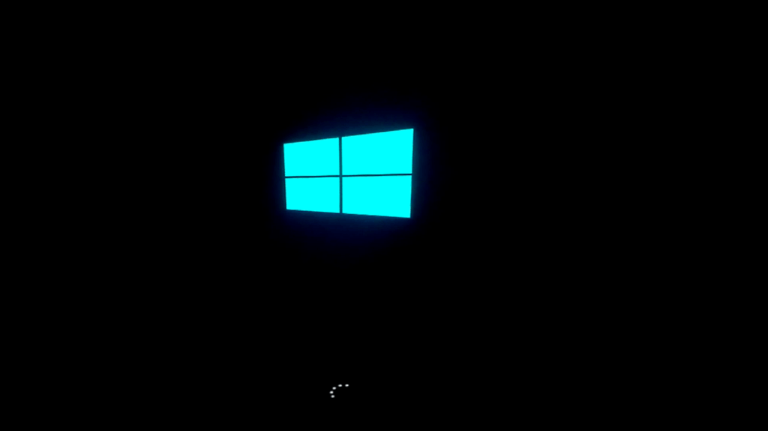

Slide 84
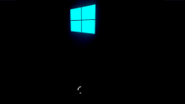
Setting up devices

Slide 85
Setting up devices 50%

Slide 86
Setting up devices 100%

Slide 87
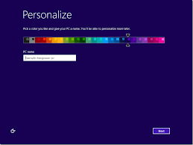

Slide 88
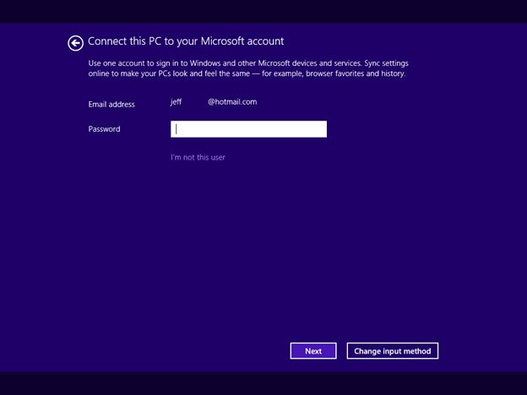

Slide 89
hi

Slide 90
This wont take long
Setting up your apps

Slide 91

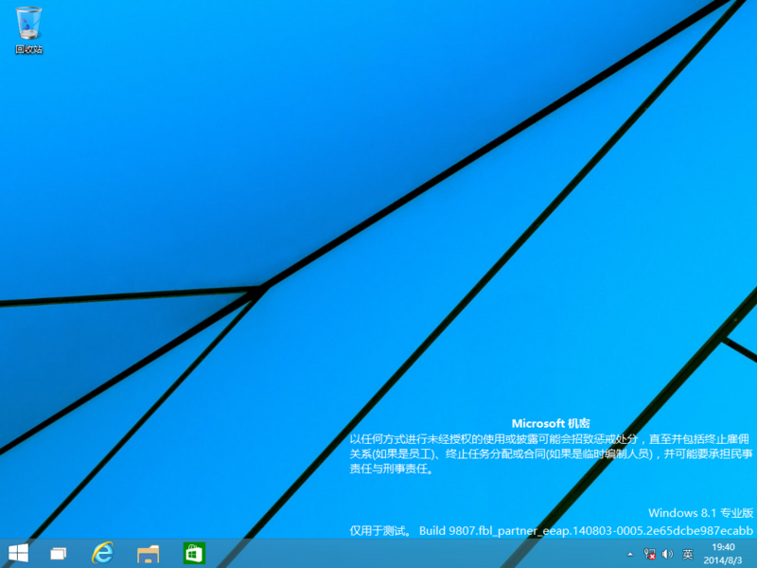

Slide 92
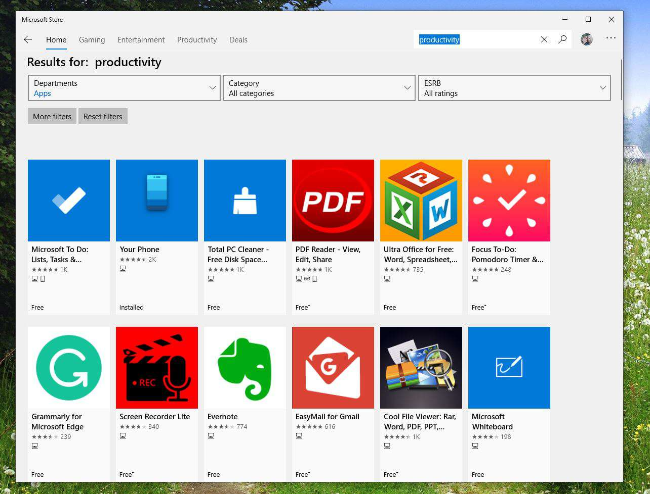

Slide 93


Slide 94
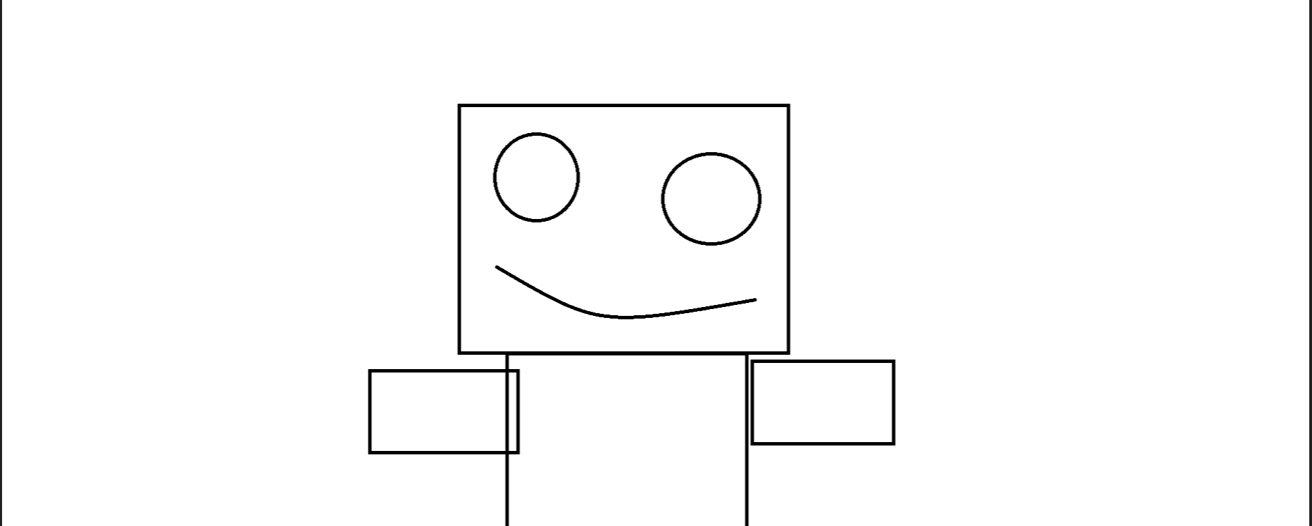

Slide 96


Slide 97


Slide 98


Slide 99
Shutting down

